Slide 1
DYNAMIC IMPLEMENTATION OF FCFS SCHEDULING
GROUP 1 PROJECT ; PRESENTED BY
UDHAV SHARMA (2021A1R003)
FARHEEN SHAAD (2021A1R013)
AARUSHI MAHAJAN(2021A1R022)

Slide 2
PROBLEM DESCRIPTION
According to the given problem statement we have to schedule the given processes using FCFS scheduling criteria so that the processes that appear first will get CPU first and the process goes on for the remaining processes .
This will lead to creating a queue and accessing the elements in the queue and putting them in the ready state .

Slide 3
WHAT IS FCFS SCHEDULING
It simply includes the jobs according to there arrival time .
The job that arrives first will get the CPU first .
The lesser the arrival time the sooner the job gets the CPU .
It may cause the problem of starvation if the burst time of the first process is way too long.

Slide 4
ALGORITHM
Step 1. Input the number of processes required to be scheduled using FCFS, burst time for each process and its arrival time.
Step 2. Using enhanced bubble sort technique, sort the all given processes in ascending order according to arrival time in a ready queue.
Step 3. Calculate the Finish Time, Turn Around Time and Waiting Time for each process which in turn help to calculate Average Waiting Time and Average Turnaround Time required by CPU to schedule a given set of processes using FCFS.
Step 3.1 : for i = 0, Finish Time T 0 = Arrival Time T 0 + Burst Time T 0
Step 3.2 : for i >= 1, Finish Time T i = Burst Time T i + Finish Time T i - 1
Step 3.3 : for i = 0, Turn Around Time T 0 = Finish Time T 0 - Arrival Time T 0
Step 3.4 : for i >= 1, Turn Around Time T i = Finish Time T i - Arrival Time T i
Step 3.5 : for i = 0, Waiting Time T 0 = Turn Around Time T 0 - Burst Time T 0
Step 3.6 : for i >= 1, Waiting Time T i = Turn Around Time T i - Burst Time T i – 1
Step 4. Process with less arrival time comes first and gets scheduled first by the CPU.
Step 5. Calculate the Average Waiting Time and Average Turnaround Time.
Step 6. Stop .

Slide 5
IMPLEMENTATION / PSEUDO CODE
The code is a function that takes in the maximum range of disk and the size of queue request.
It then creates an array called queue with 20 elements, each representing a position on the disk.
The head is initialized to 0 and for each iteration, it calculates how much time it will take to read from this position by using seek=diff; where diff is the difference between two consecutive positions on the disk.
The code then prints out how long it took to move from one position to another as well as what was being read at that point in time.
After calculating average seek time, it prints out total seek time and average seek time for comparison purposes.
The code is a program that implements the FCFS Disk Scheduling Algorithm.
The algorithm starts by asking for the maximum range of disk to be used, which is specified in max.
Then, it asks for the size of queue request (the number of disks) and enters 20 into queue[].
It then prints out a list of values from 0 to 19, each representing an individual disk position.
The next step is to initialize head with 0 and enter the initial head position into head.
This will represent where on the disk we want to start reading data from.
After this point, it goes through all 20 disks in order starting with 0 and ending at 19, until it reaches n-1 (the last disk).
For each disk in

Slide 6
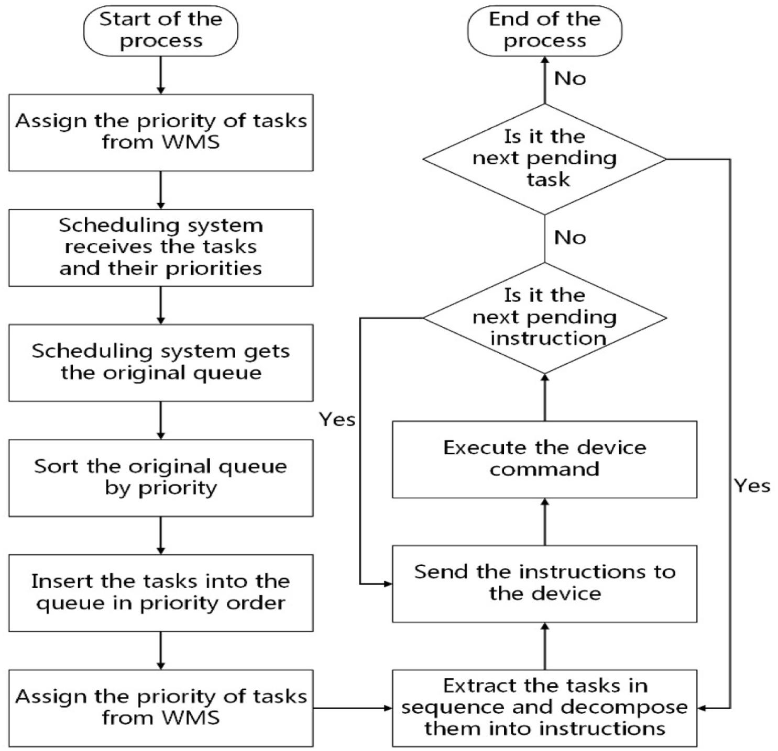
FLOWCHART

Slide 7
ADVANTAGES
Simple
User friendly
Easy to implement
First come first served

Slide 8
DISADVANTAGES
Long waiting time
Lower device utilization
Favours Cpu over I/o
Not ideal for time-sharing

Slide 9
REFERENCES
Algorithm: https://iq.opengenus.org/first-come-first-serve-cpu-scheduling/
Implementation : https://www.geeksforgeeks.org/program-for-fcfs-cpu-scheduling-set-1/
Flowchart : https://www.researchgate.net/figure/Flowchart-of-FCFS-Algorithm_fig2_301648483

Slide 10
THANK YOU

